Slide 1
Object counting
Color algorithm

Slide 2
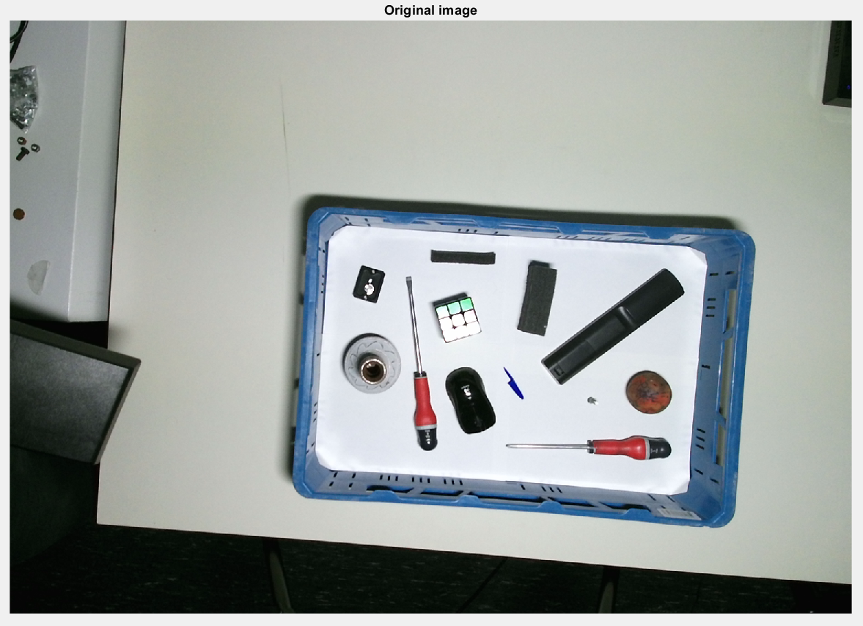
REMOVING BACKGROUND (with depth data)

Slide 3
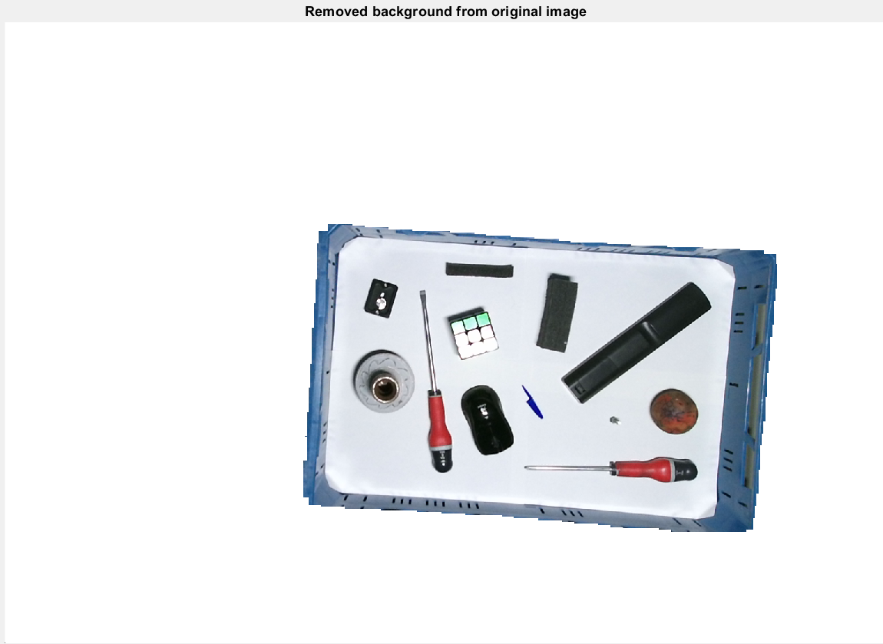
Converting to greyscale and blurring.

Slide 4
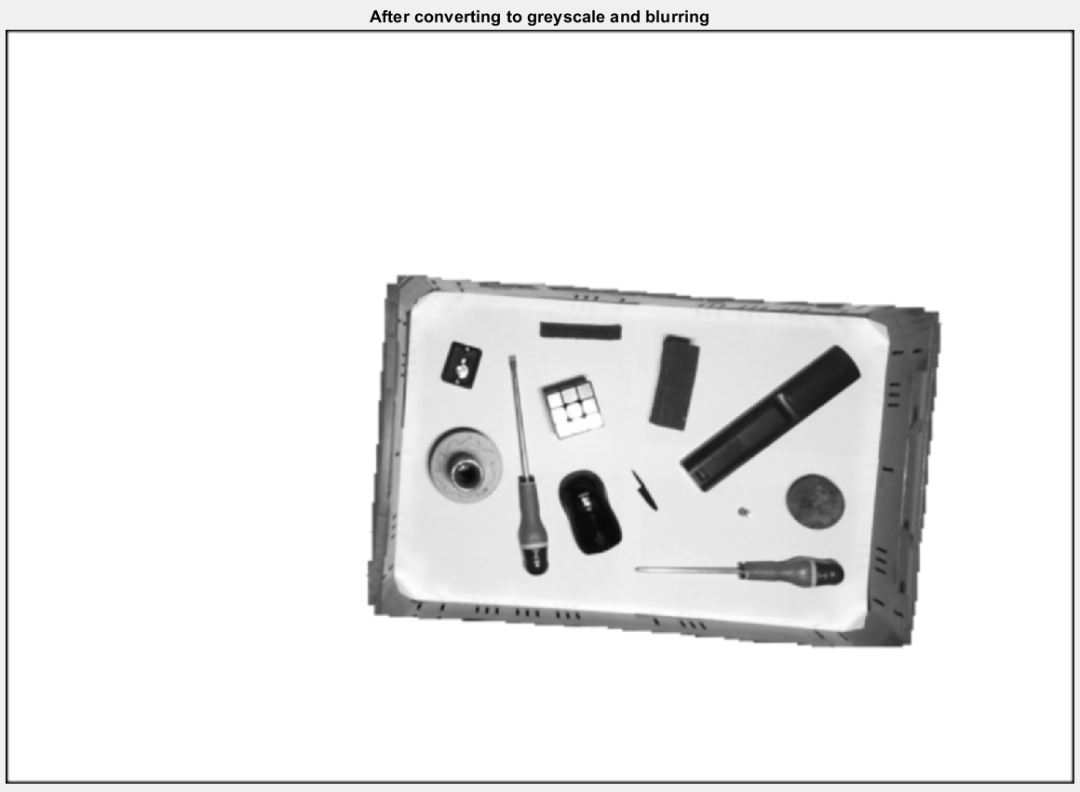
Edge detection (Laplacian filter)

Slide 5
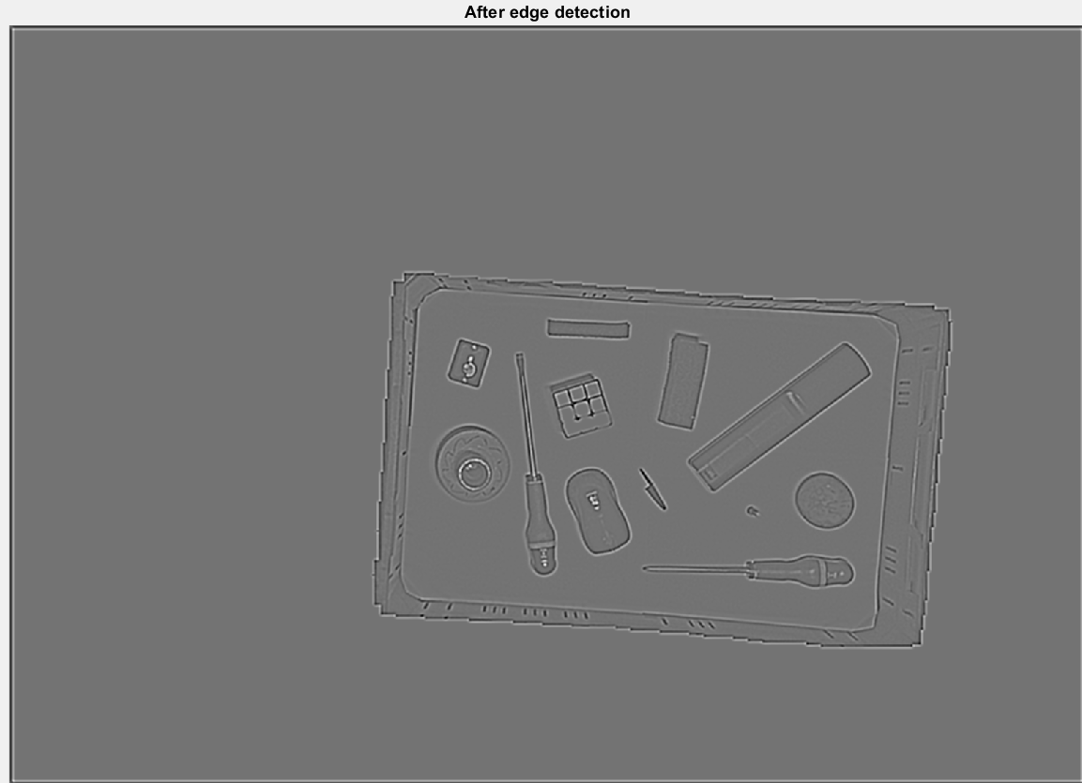
Thresholding the edges (fixed threshold value)

Slide 6
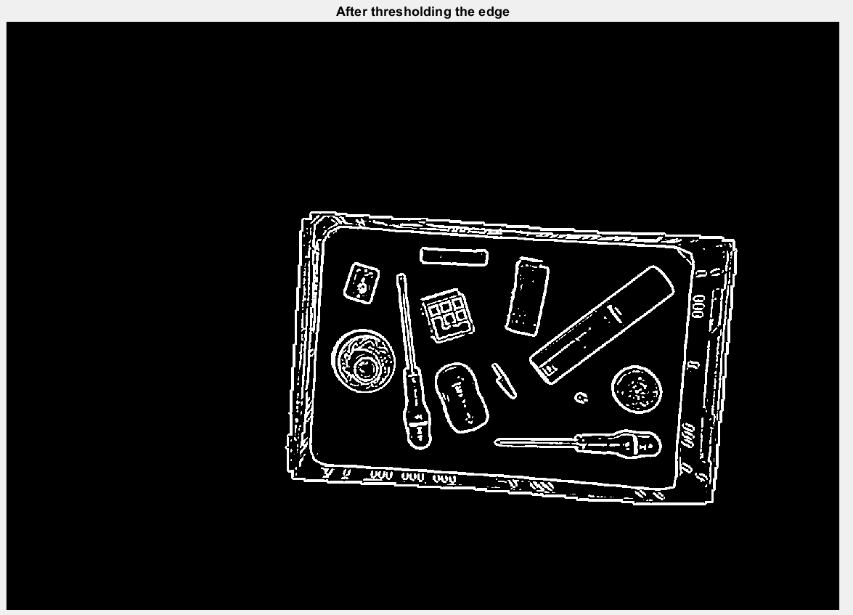
Grouping pixels

Slide 7
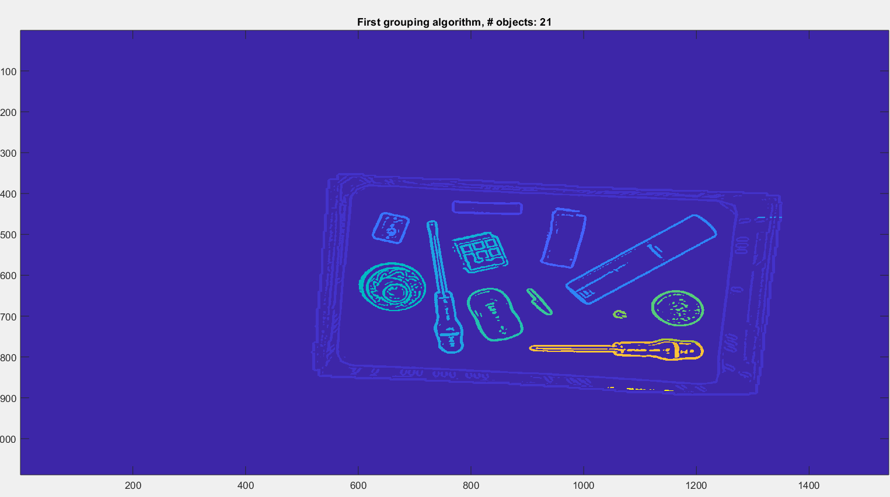
Regrouping pixels

Slide 8
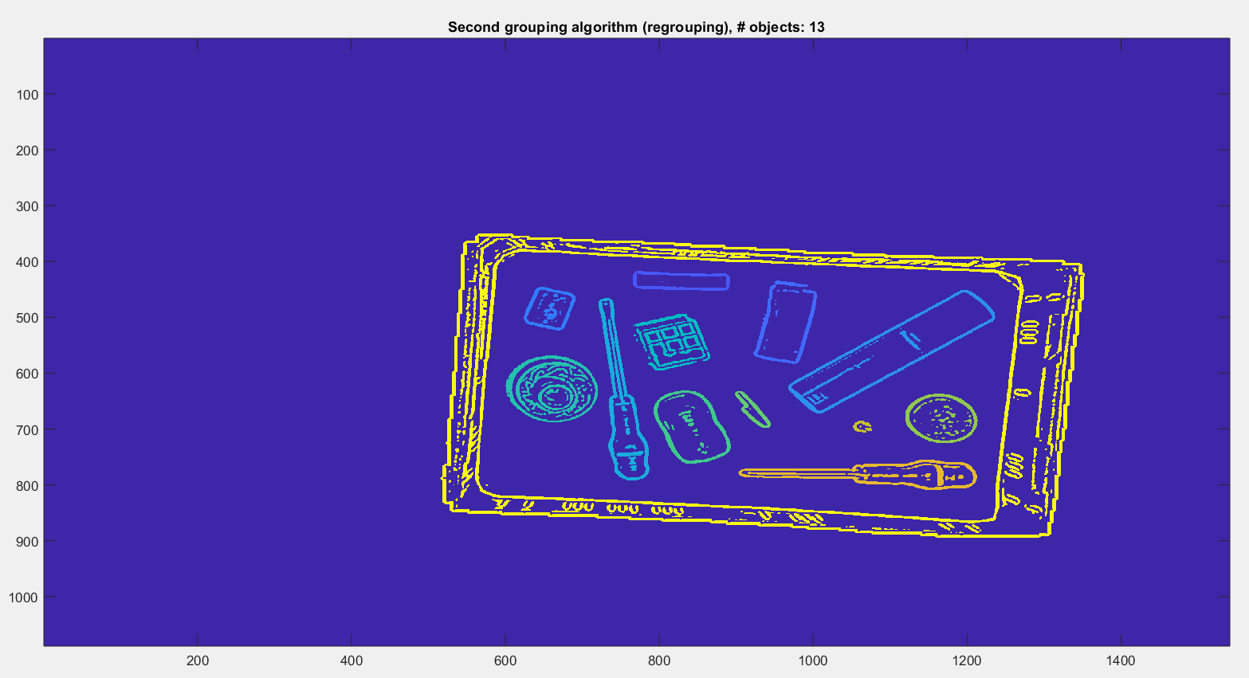
Drawing boundary boxes on the original image

Slide 9
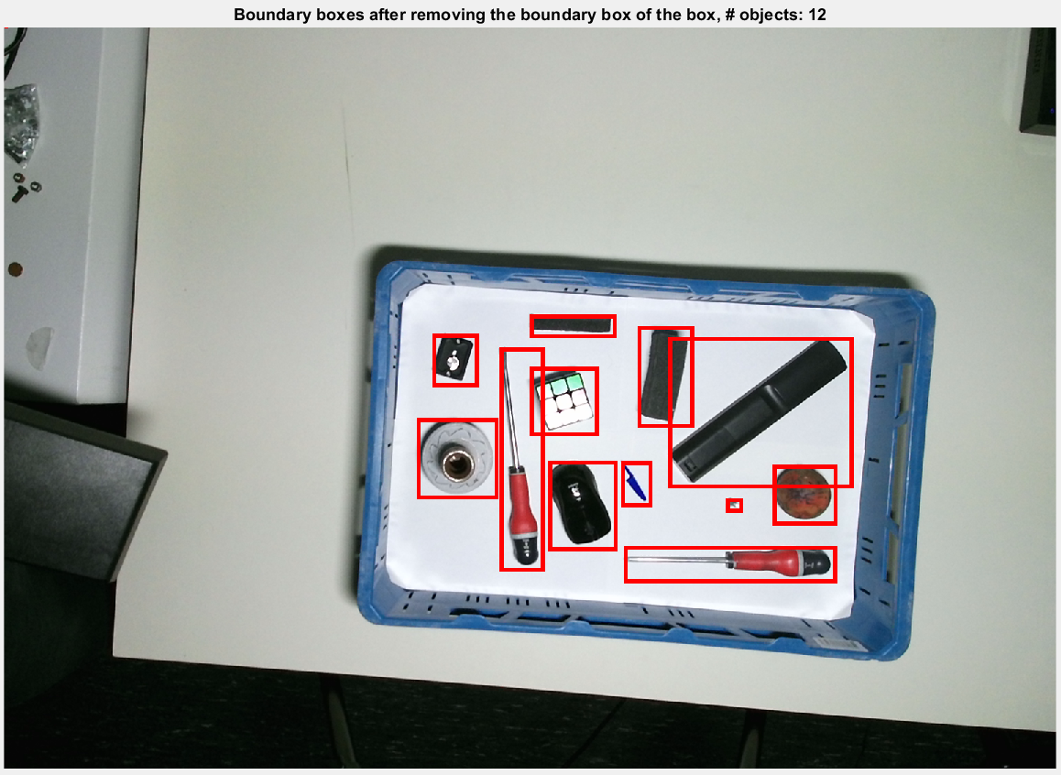

Slide 10
How does it work?

Slide 11
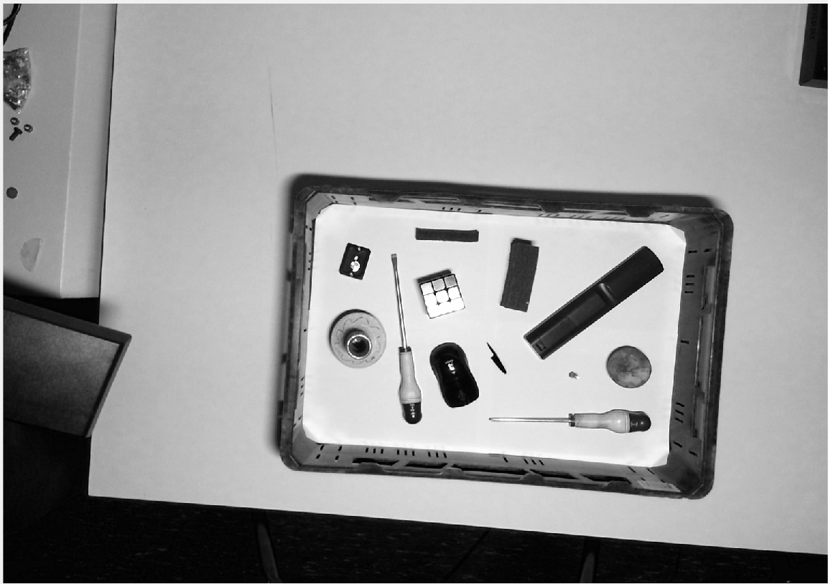
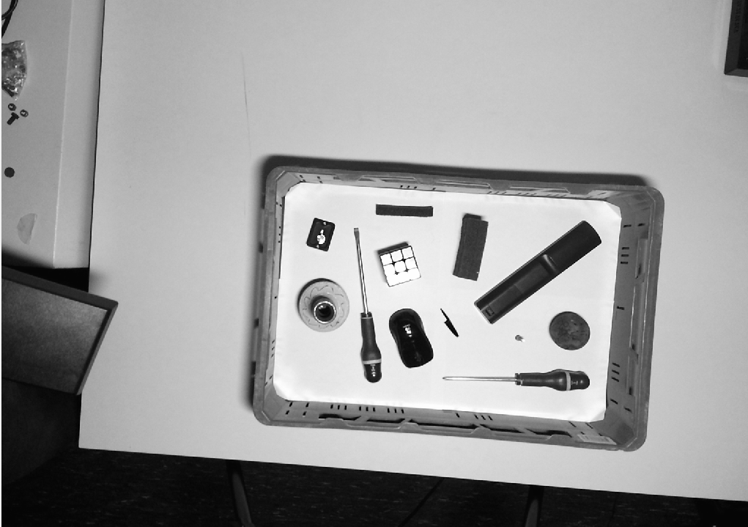
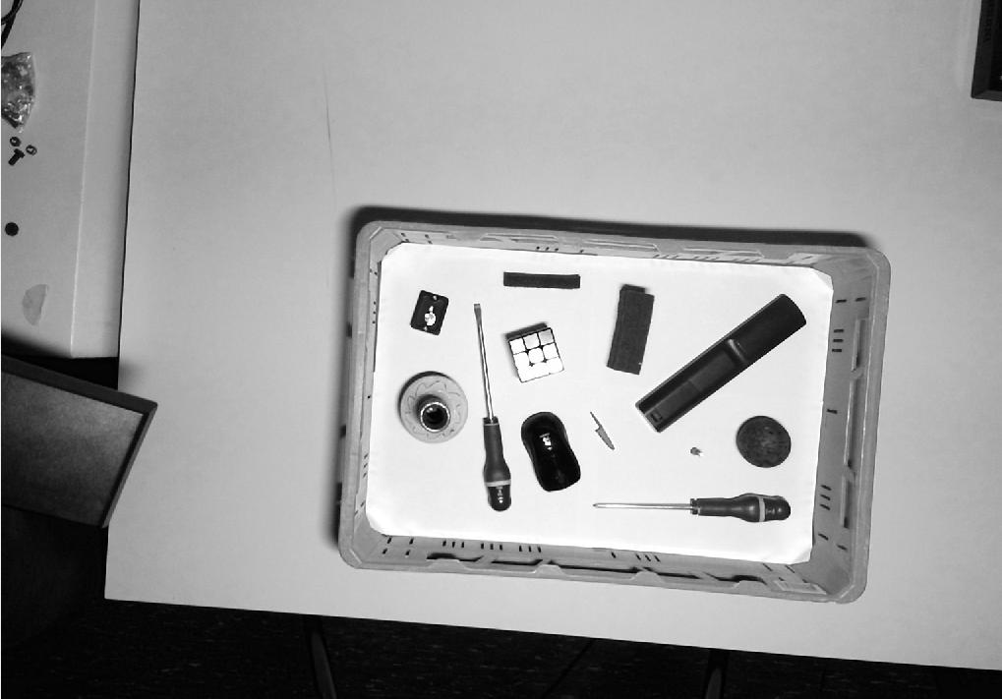
Step 1: converting to greyscale
Red
0.2989
Green
0.5870
0.1140
Blue

Slide 12
Step 2: Blurring
Mean blur
Gaussian blur

Slide 13
Step 3: edge detection
*
=

Slide 14
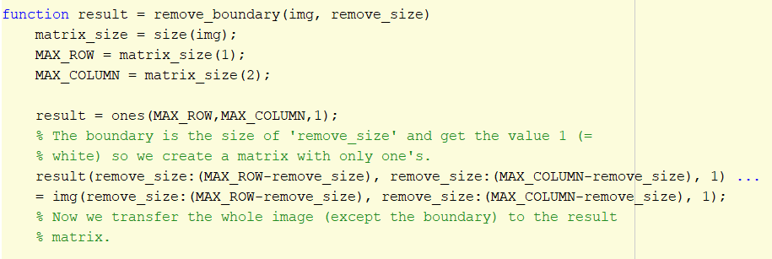
Step 4: remouving boundary
Because we use a Gaussian blur, we get a black boundary around the image.

Slide 15
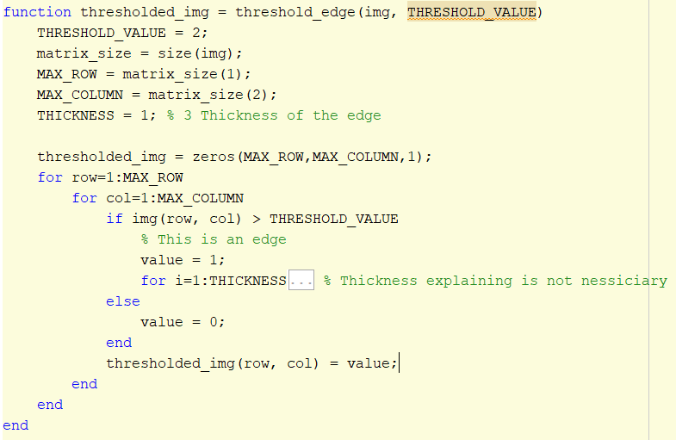
Step 5: thresholding the edge

Slide 16
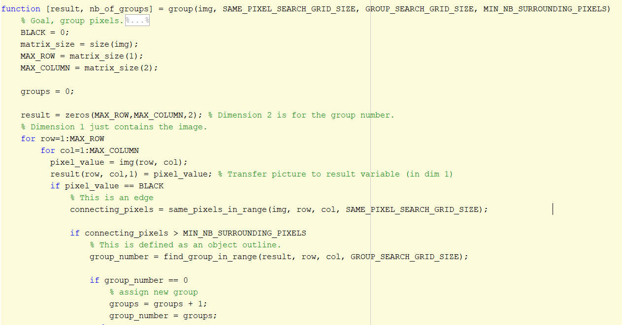
Step 6: grouping pixels

Slide 17
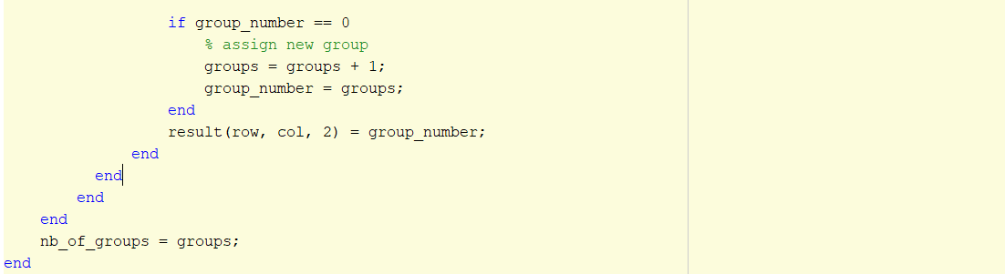

Slide 18
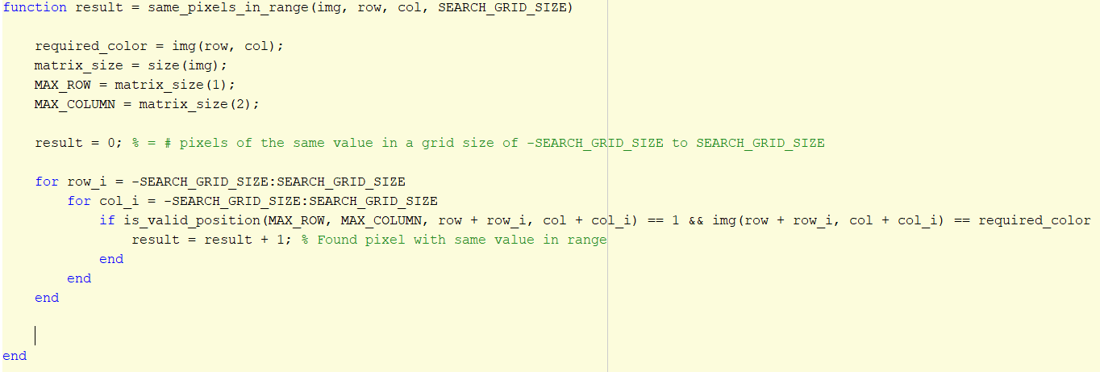

Slide 19
Step 6: grouping pixels

Slide 20
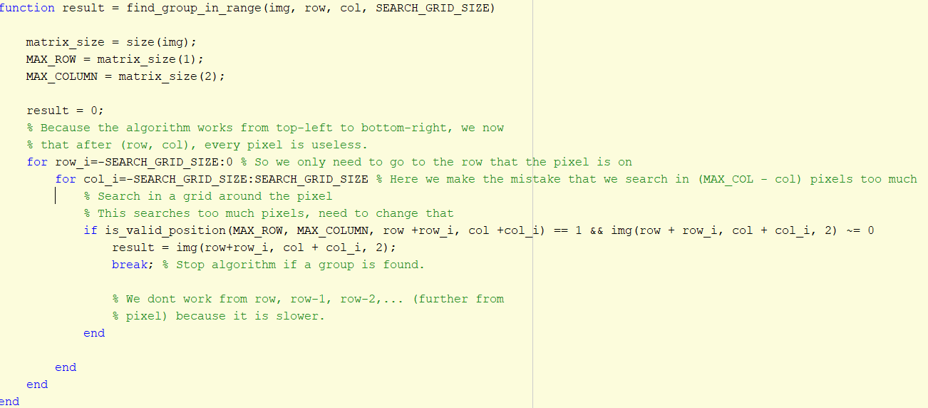

Slide 21
Step 6: grouping pixels

Slide 23
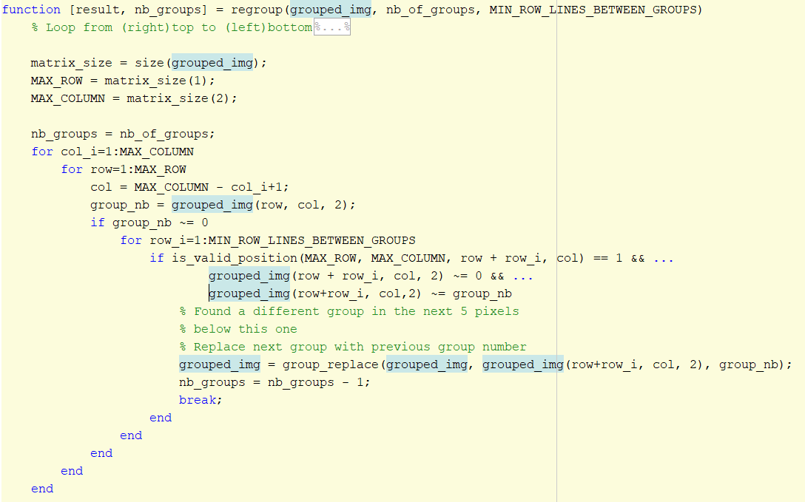
Step 7: regrouping

Slide 24
